Slide 1
Wellcome Trust Advance Course:
Module 8: Genome assembly
Thomas Keane
EMBL-EBI
tk2@ebi.ac.uk
Shane McCarthy
Department of Genetics, University of Cambridge
sam68@cam.ac.uk

Slide 2
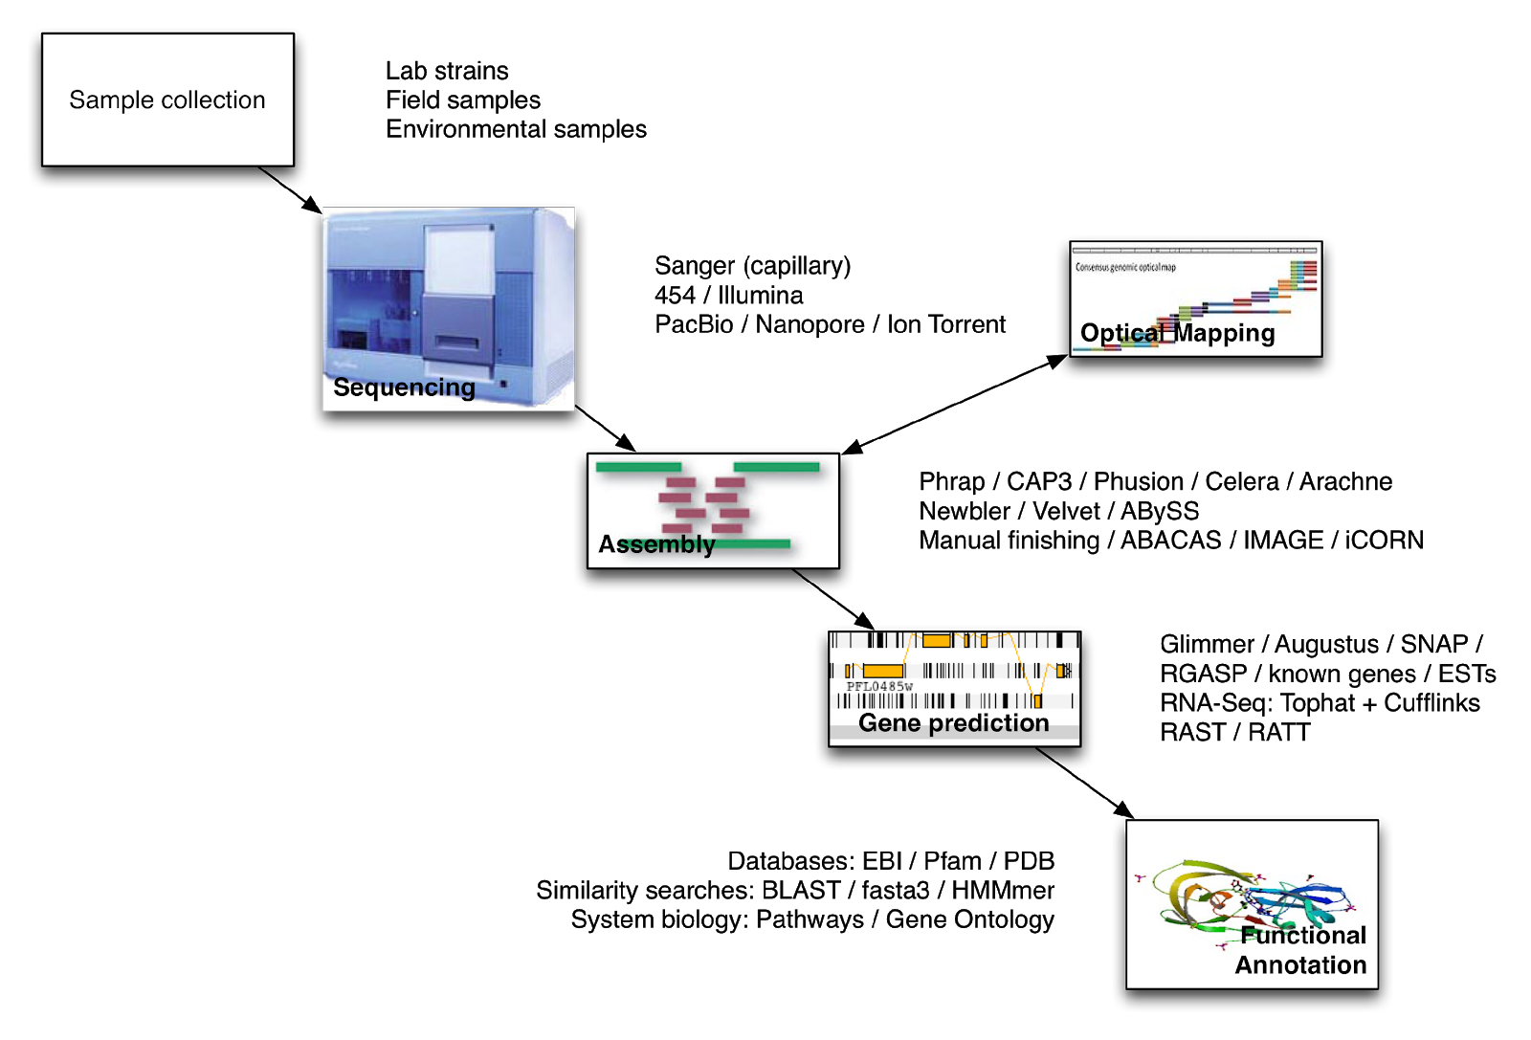
Introduction to genome assembly

Slide 3
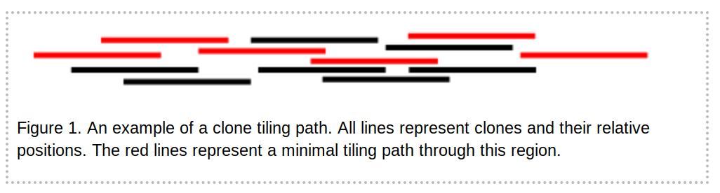
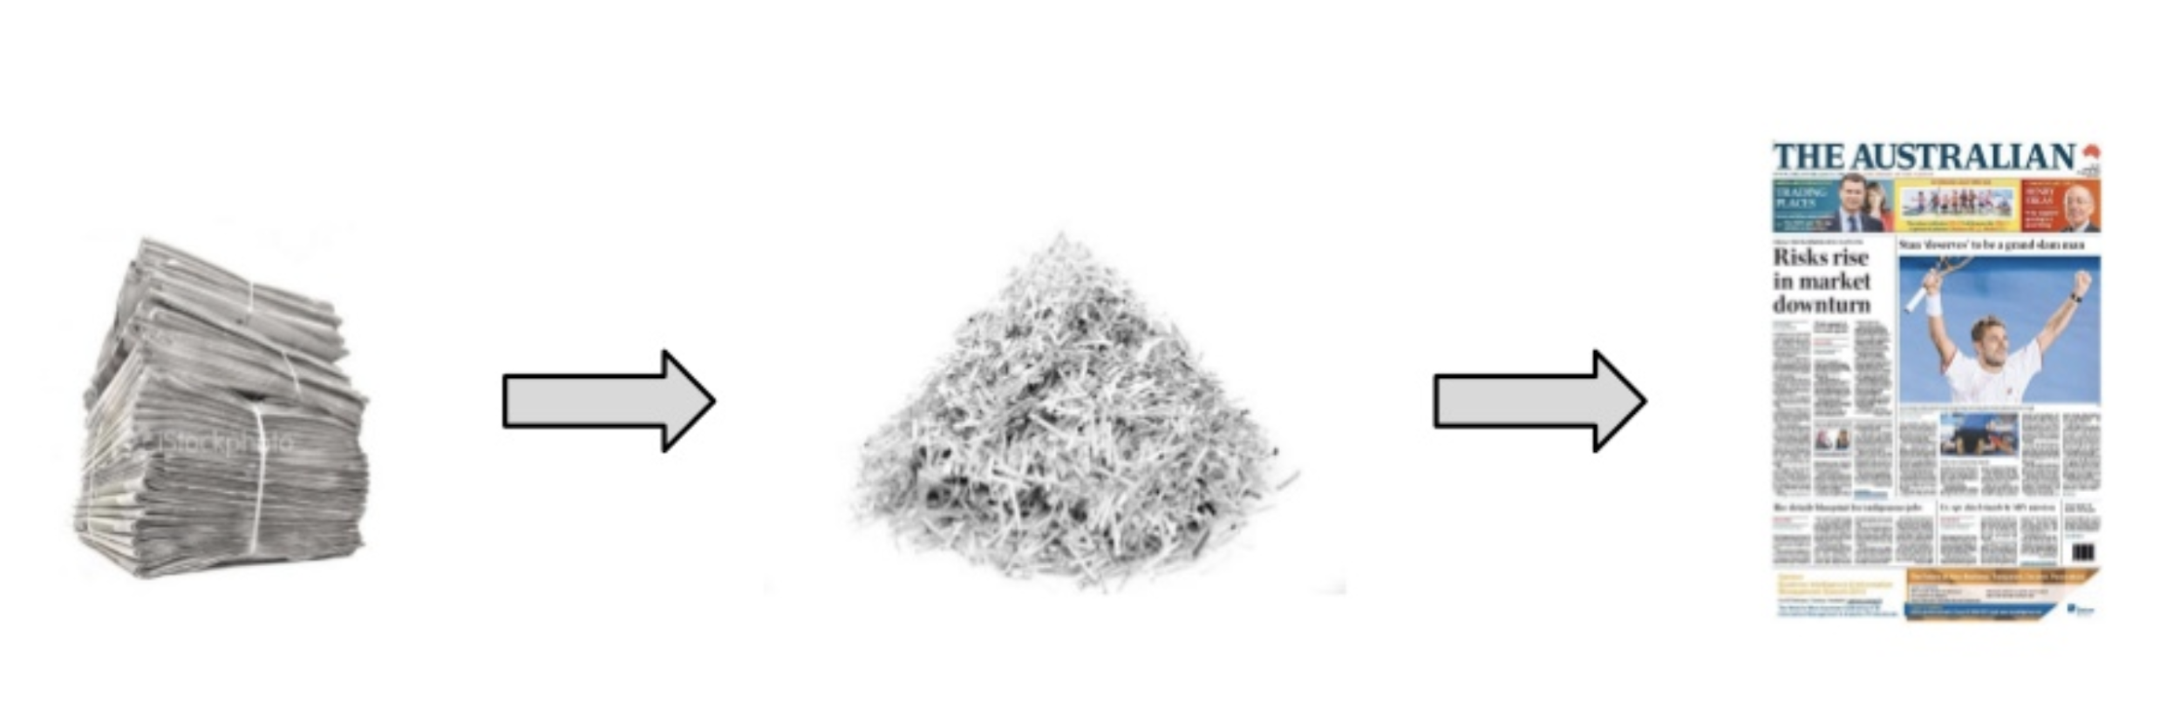
What is genome assembly?
Sequencing technologies can only sequence short stretches of DNA
Given many (millions or billions) of reads, produce a linear (or perhaps circular) genome
Clone based
Select clones using markers
Sequence clones separately
Whole-genome shotgun
Fragment whole-genome and sequence
De novo assembly: reconstruct the genome sequence from the sequenced fragments

Slide 4
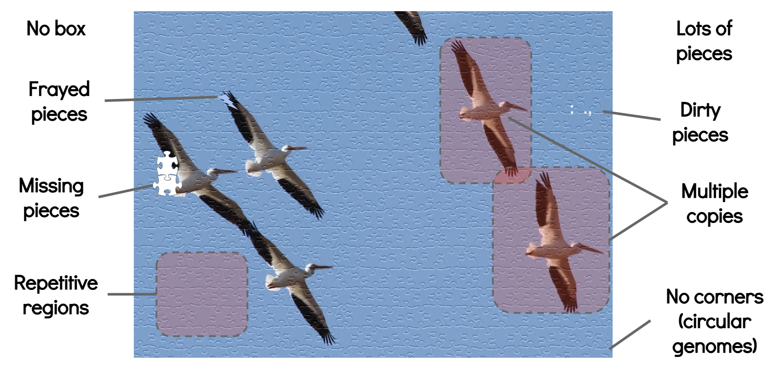
What makes a jigsaw puzzle hard?
What helps? Larger pieces (read length); fewer dirty or frayed pieces (errors in reads). fewer repeats and copies…
Torsten Seemann

Slide 5
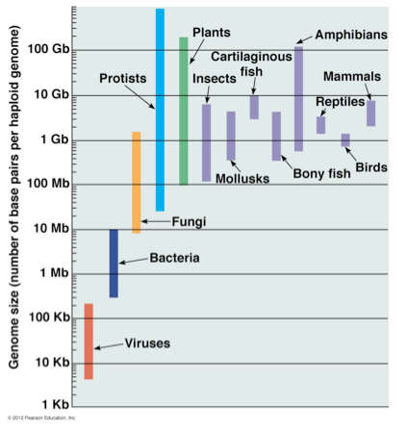
Key considerations
sequencing coverage
errors in reads
reads lengths
non-uniqueness of the genome (repeats)
genome size
genome heterozygosity and ploidy
running time and memory

Slide 6
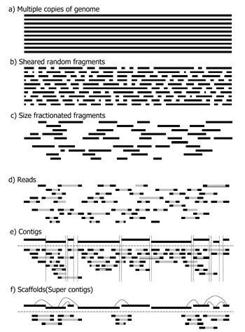
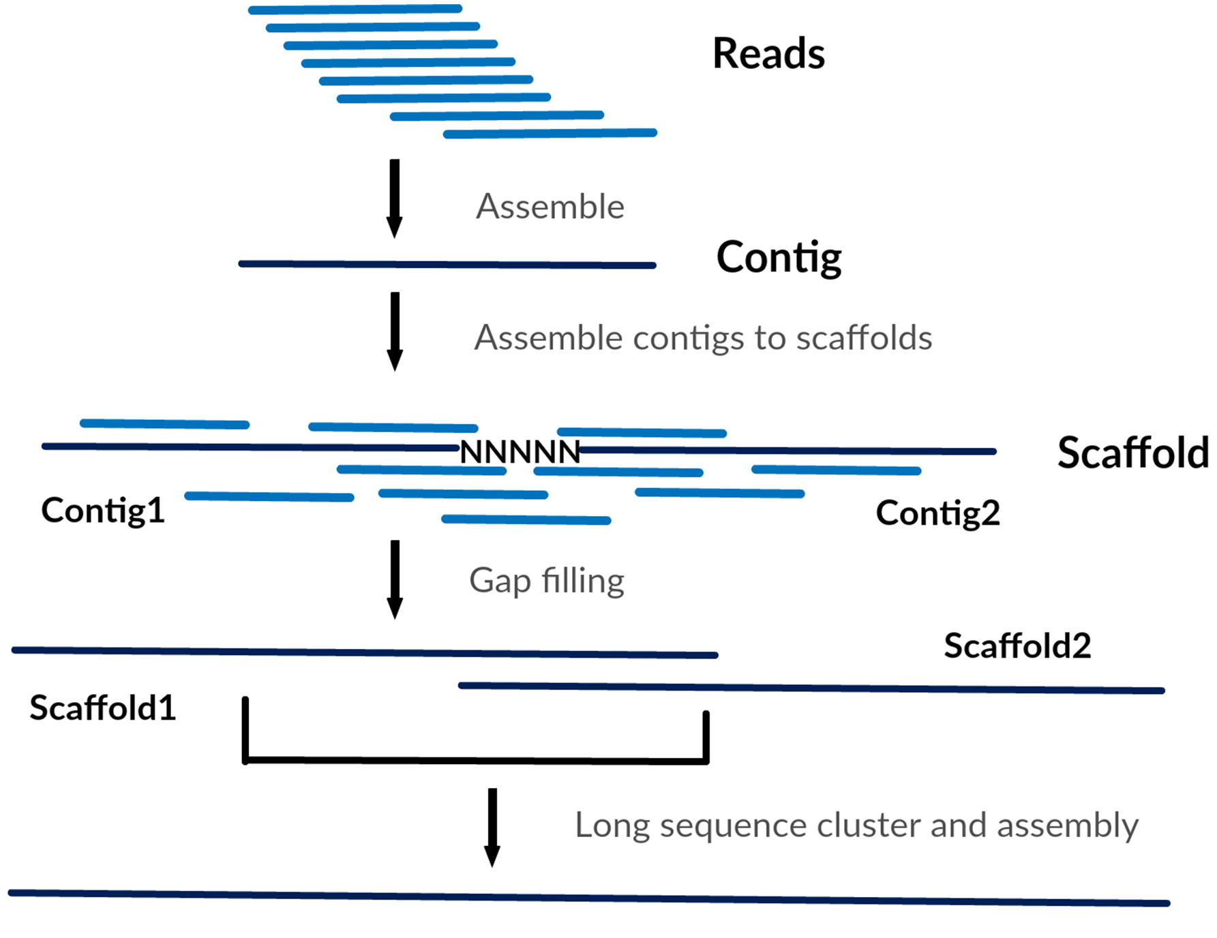
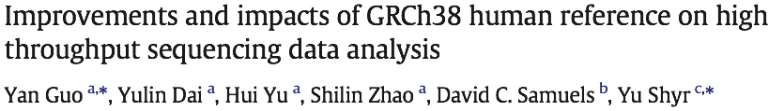
Terminology
Chromosome
contig: contiguous stretch of assembled sequence
scaffold: ordered set of contigs with gaps (Ns) place between

Slide 7
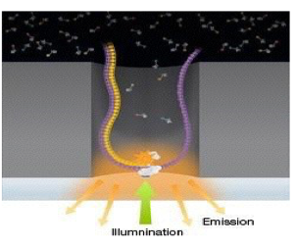
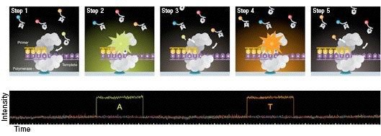
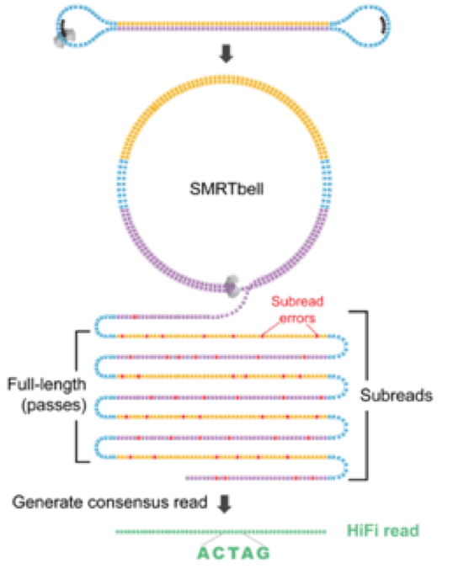
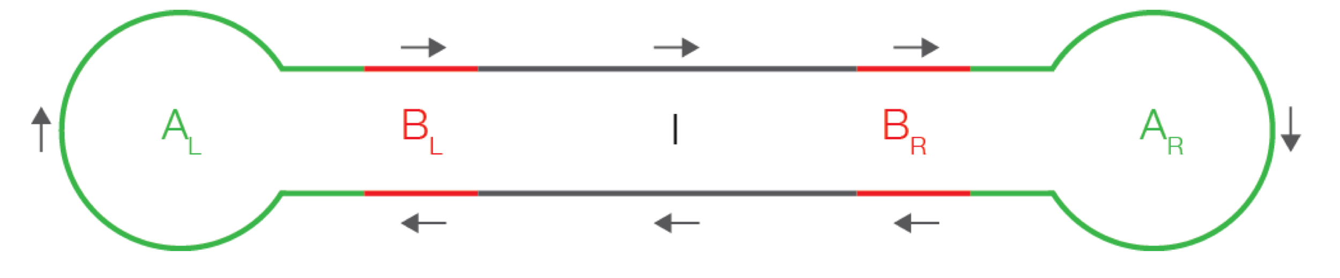
PacBio sequencing
Key points:
1 DNA molecule and 1 polymerase in each well (zero-mode waveguide, ZMW)
4 colours flash in realtime as polymerase acts
Methylated bases have distinct pattern
No theoretical limit to DNA fragment length
Slides from Ira Hall, via Jared Simpson

Slide 8
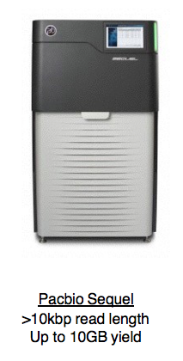
PacBio sequencing and assembly
Advantages:
Long read lengths
Few systematic errors
Can detect some base modifications
Can get more accuracy, if you loop over the ZMW multiple times - circular consensus sequencing (CCS)
Disadvantages:
High read error rate
High cost per-base
2019 Update:
Sequel II launched with 8-fold increase in yield and improvement in CCS accuracy (HiFi reads).
Slides from Ira Hall, via Jared Simpson

Slide 9
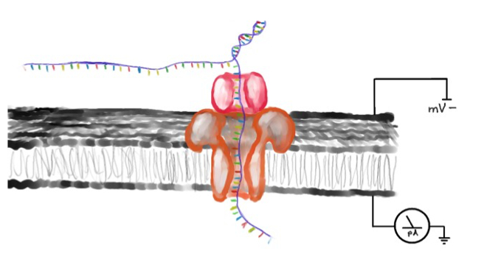
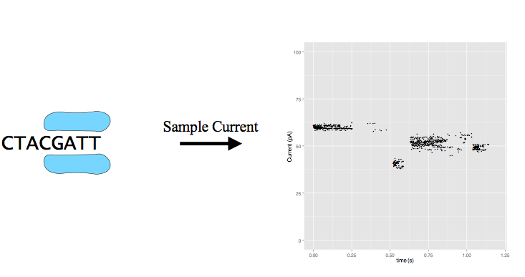
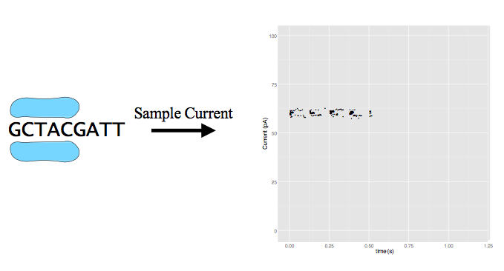
Nanopore sequencing
Illustration by David Eccles

Slide 10
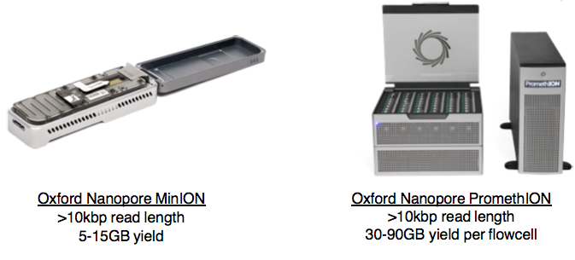
Nanopore sequencing and assembly
Advantages:
Portability and low capital cost
Read lengths up to 1Mbp reported
Base modification detection
Sequence RNA directly
Disadvantages:
High error rate
Systematic errors around homopolymers
Slides from Ira Hall, via Jared Simpson

Slide 11
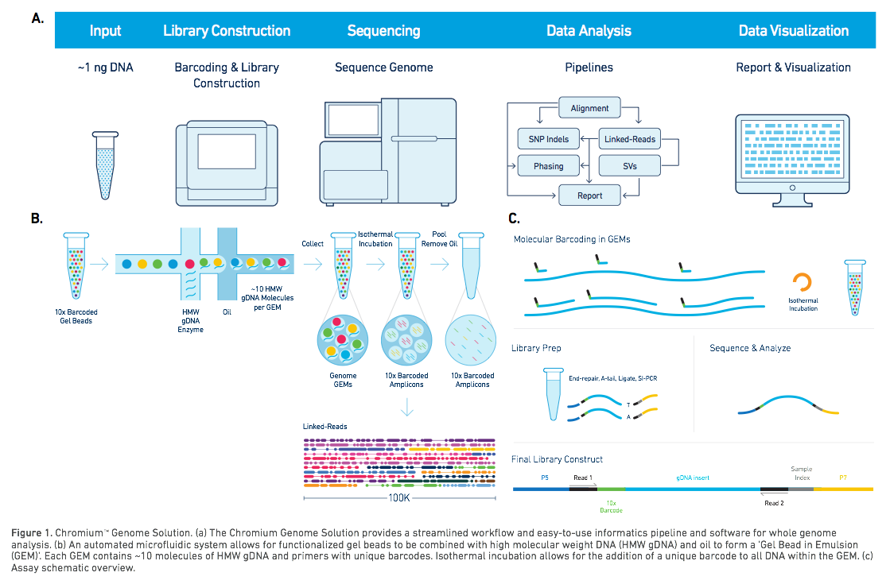

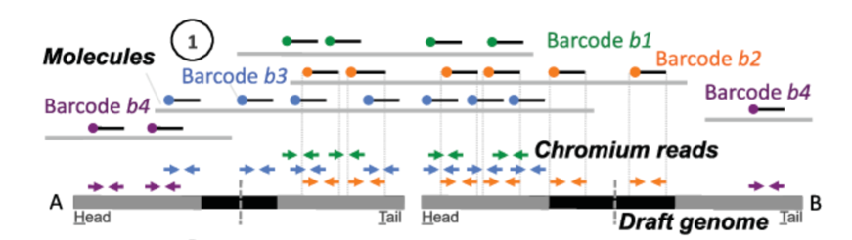
Read clouds or linked reads
Longer range “read clouds” e.g. from 10X Genomics Chromium, can bridge bigger repeats/gaps
Multiple reads from a long ~100kb template sharing a barcode
Yeo S, Coombe L, Warren RL, Chu J, Birol I. ARCS: scaffolding genome drafts with linked reads. Bioinformatics. 2018.

Slide 12
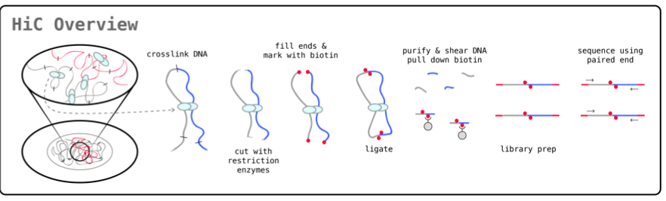
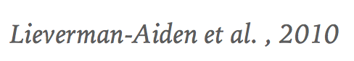

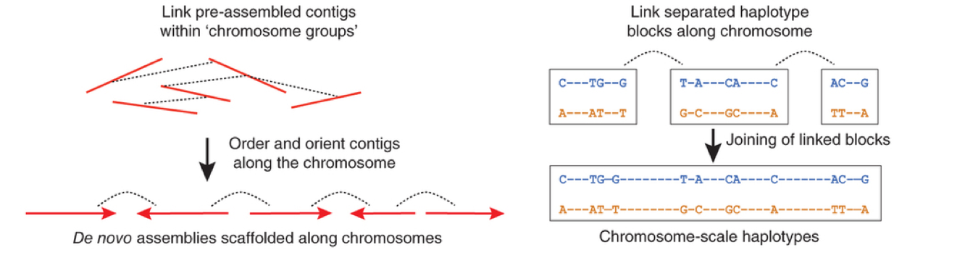
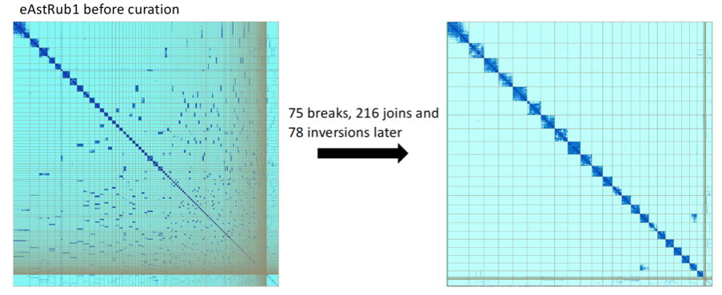
Hi-C
https://github.com/ArimaGenomics/mapping_pipeline/raw/master/Arima_Mapping_UserGuide.pdf
Hi-C “proximity ligation”
is used to look at local chromatin organisation, but globally most Hi-C links are on the same chromosome, and more are close than distant
Automated tools (e.g. SALSA2, 3d-dna)
Visualisers (e.g. Juicer, Hi-Glass)
Editors (e.g. Juicer, Pretext)

Slide 13
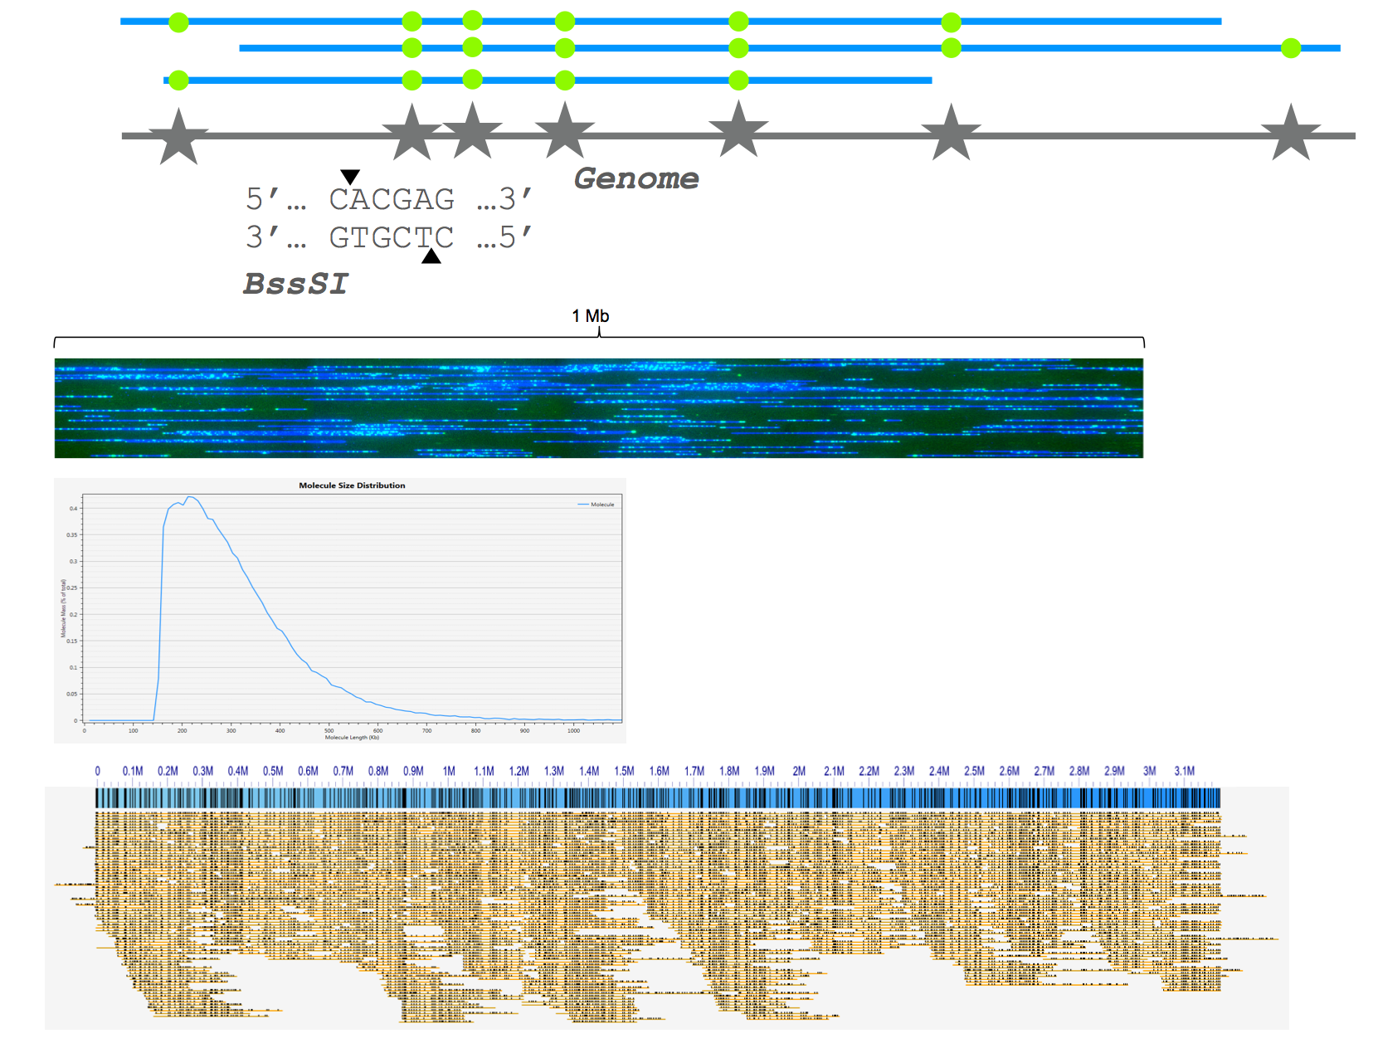
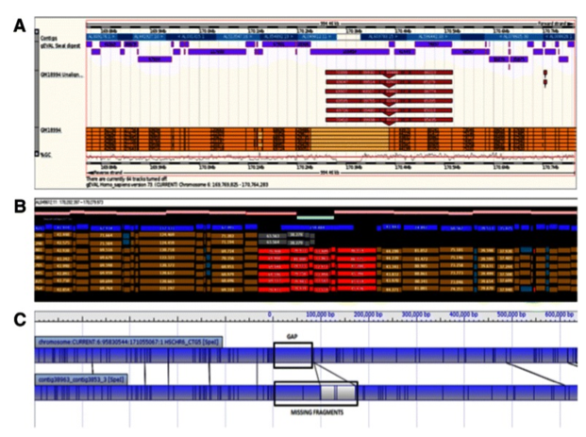

Optical mapping
Isolate high molecular weight DNA fragments
Label specific sequence motifs across the entire genome
Linearise and image labelled DNA
Restriction digest maps give approximate spacing of restriction sites (short sequence motifs), skipping over repeats
Now scaled up by dedicated optical imaging machines, e.g. BioNano

Slide 14
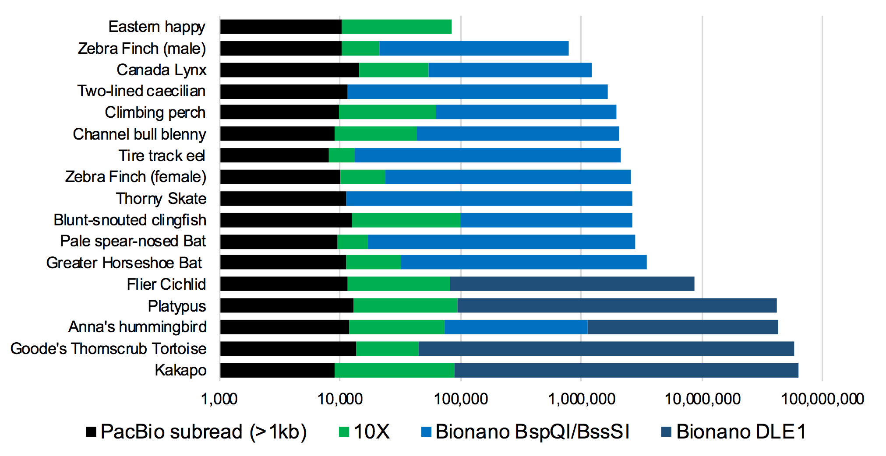
Long-range technologies

Slide 15
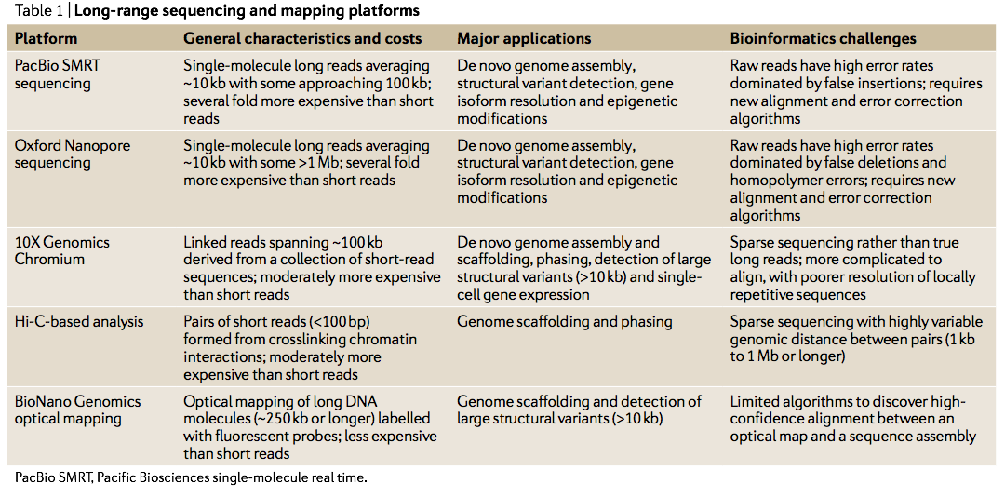
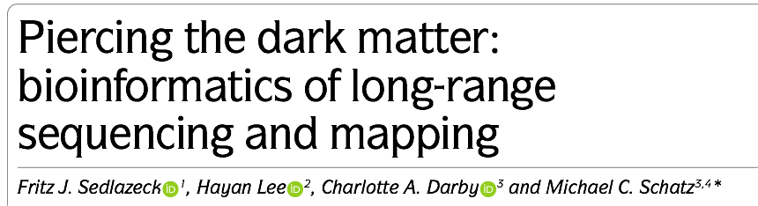
Long-range technologies

Slide 16
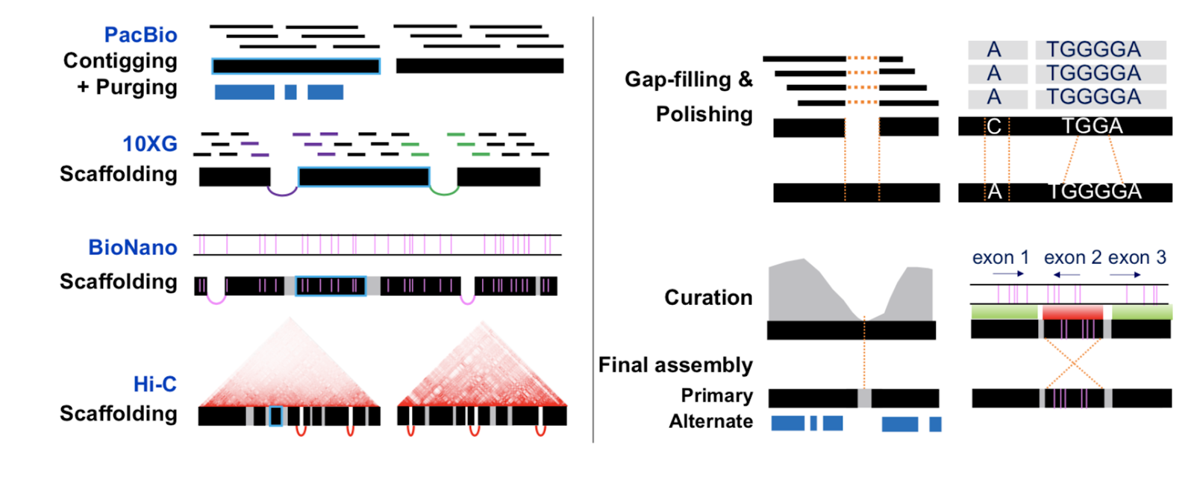
Example genome project workflow
Vertebrate Genomes Project

Slide 17
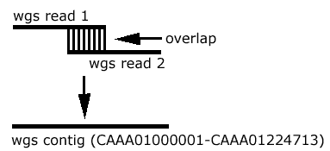
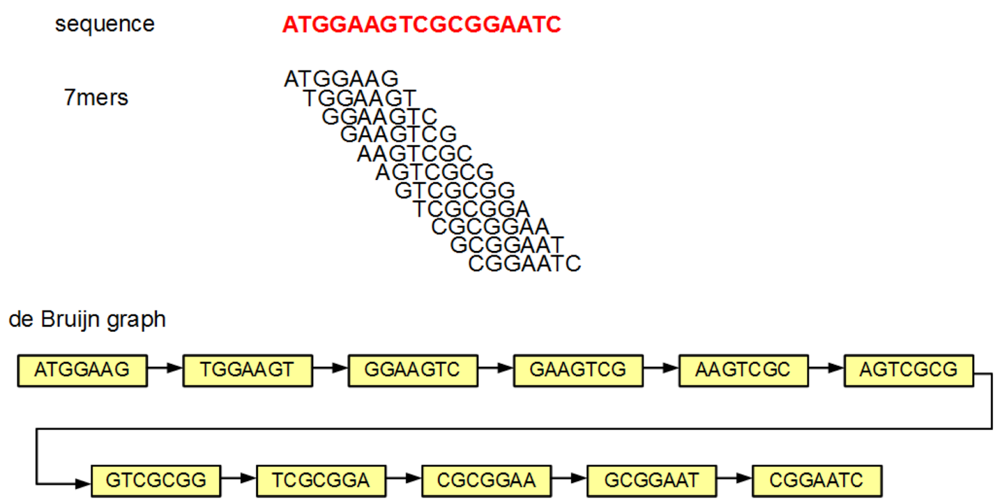
Assembly: contig generation
OLC (Overlap Layout Consensus):
For all pairs x, y, of reads
determine if there is sufficient overlap
bundle stretches of overlap graph into contigs
Computationally expensive (quadratic scaling with current approaches)
Assembly software
Falcon (PacBio), Canu (PacBio, ONT), minimap/miniasm
DBG: de Bruijn graph (k-mer):
Build a graph of all subsequences of length k.
Assembly software
velvet, ABySS, SPAdes, wtdbg2

Slide 18
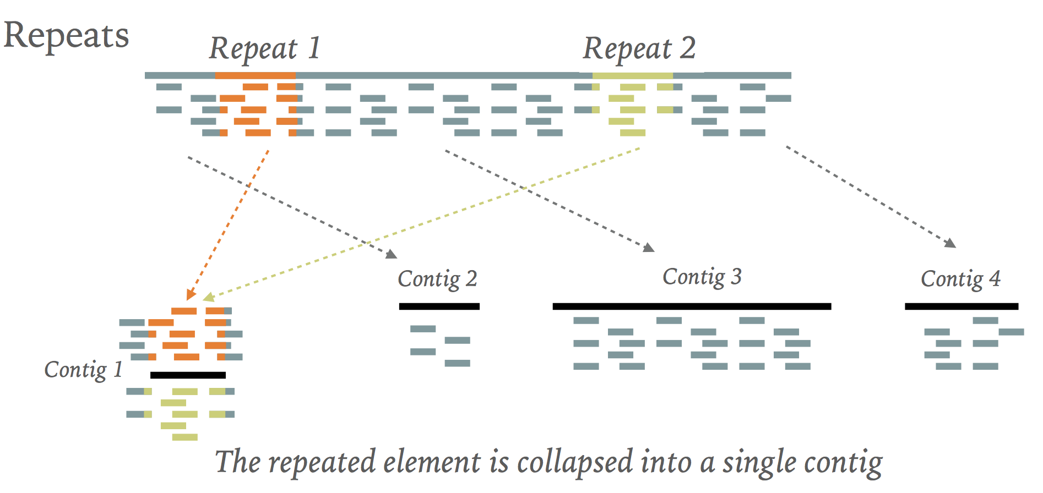
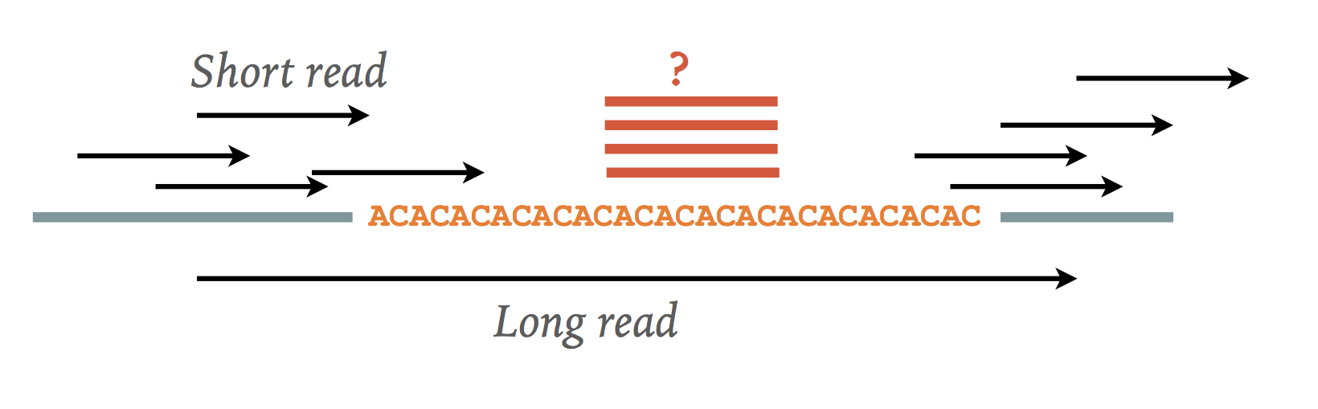
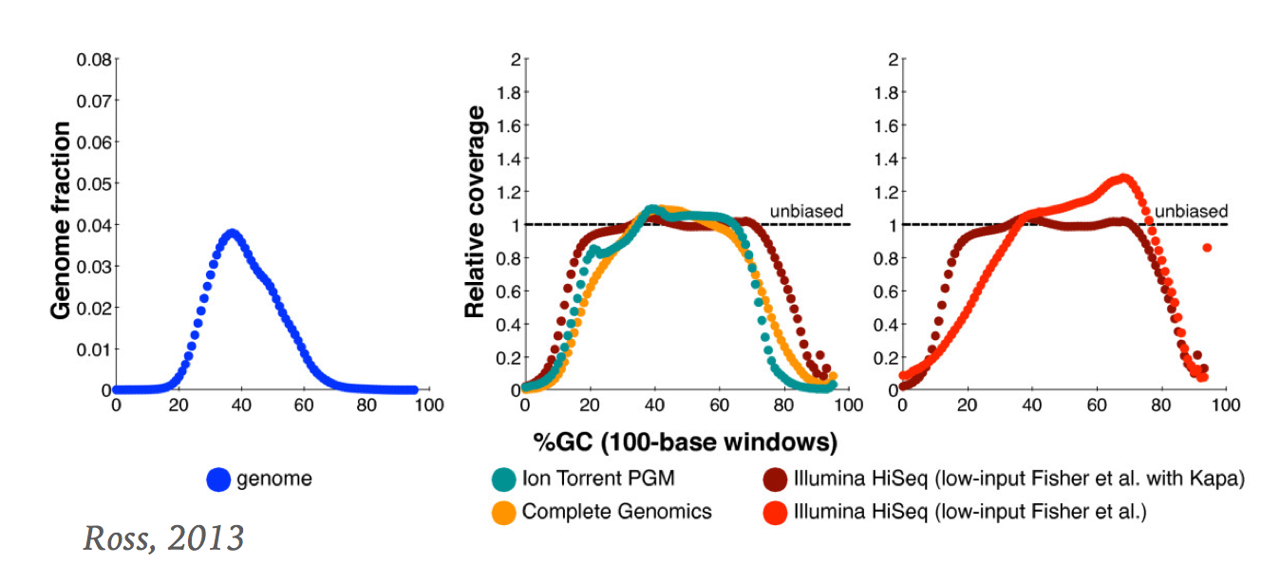
Hurdles
Heterozygosity
Sequencing errors
Repeats
Low complexity genomic regions
Base composition and sequencing bias

Slide 19
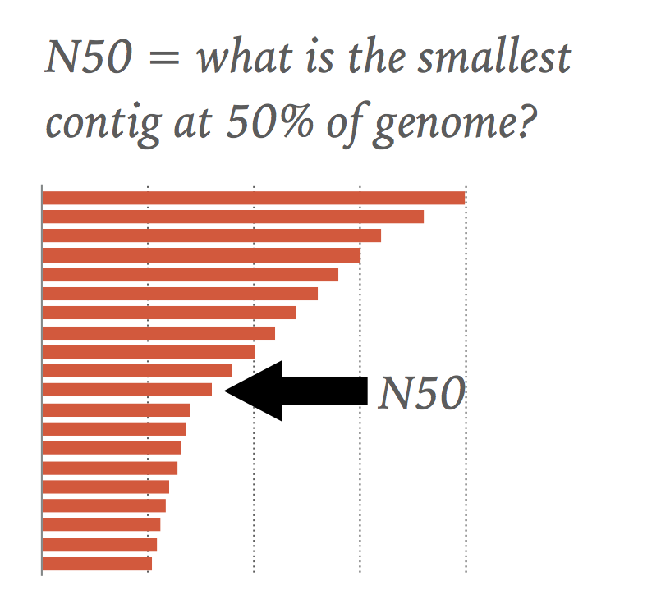
Assembly metrics
total length
number of sequences (contigs and scaffolds)
average length (contigs and scaffolds)
largest/smallest (contigs and scaffolds)
N50 = X means 50% of the genome is in sequences larger than X
NG50 (N50 scaled by the expected genome size)
Gene content (% conserved core genes mapped)

Slide 20
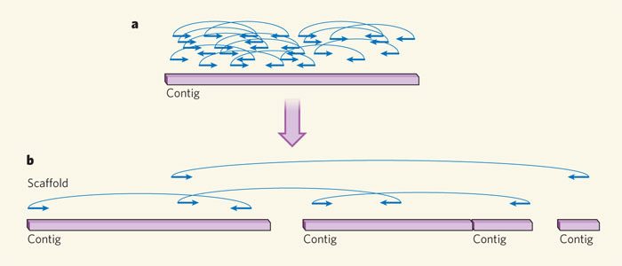
Scaffolding
Goal: Order and orient the contigs into larger structure
Construct libraries of varying insert sizes
Smaller size (2, 4 or 6 Kb), intermediate size (10-40 Kb), and libraries with large insert sequences (>100 Kb)
Ends of these clones are sequenced, generating sequence reads.
Sources of evidence
Mate-pair illumina libraries
Fosmid ends
Bacterial artificial chromosomes
10x Genomics linked reads
Hi-C
Optical maps
Gaps consisting of N (unknown) bases are inserted between contigs

Slide 21
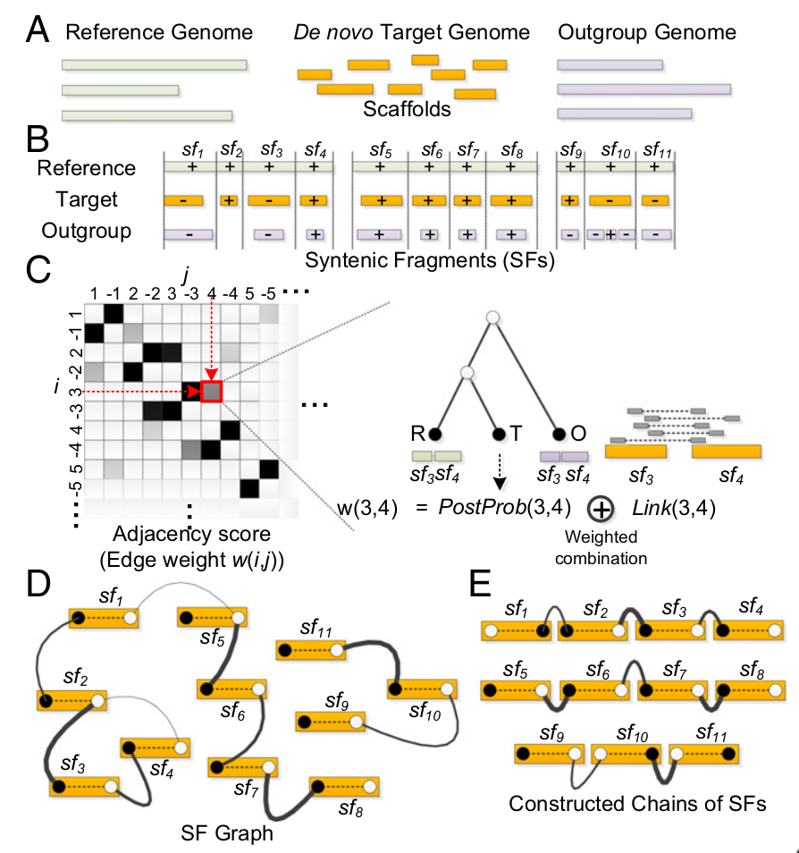
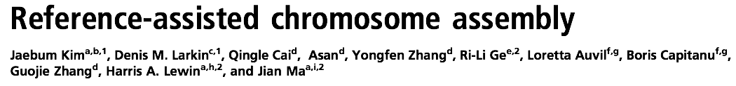
(Pseudo) chromosome assignment
Goal: Assembly of chromosome-scale DNA fragments from scaffolds
Sources of evidence
A close reference genome and/or outgroup genome
Genetic markers or map
RACA software
Input: Reference genome, de novo assembly, and one or more outgroups (A)
Identify syntenic fragments (B)
Calculate likelihood of adjacencies (C)

Slide 22
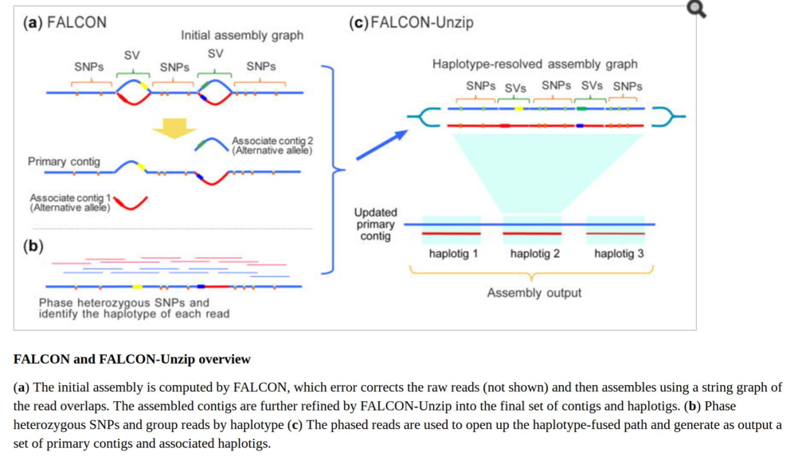
Diploid assembly
Almost all assemblers assume genome is haploid
Ignore allelic variation between parental chromosomes
Diploid assembly: Produce two haplotype phased genomes
e.g. Falcon-unzip
Chin et al. (2016)
Nat Methods

Slide 23
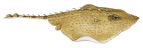

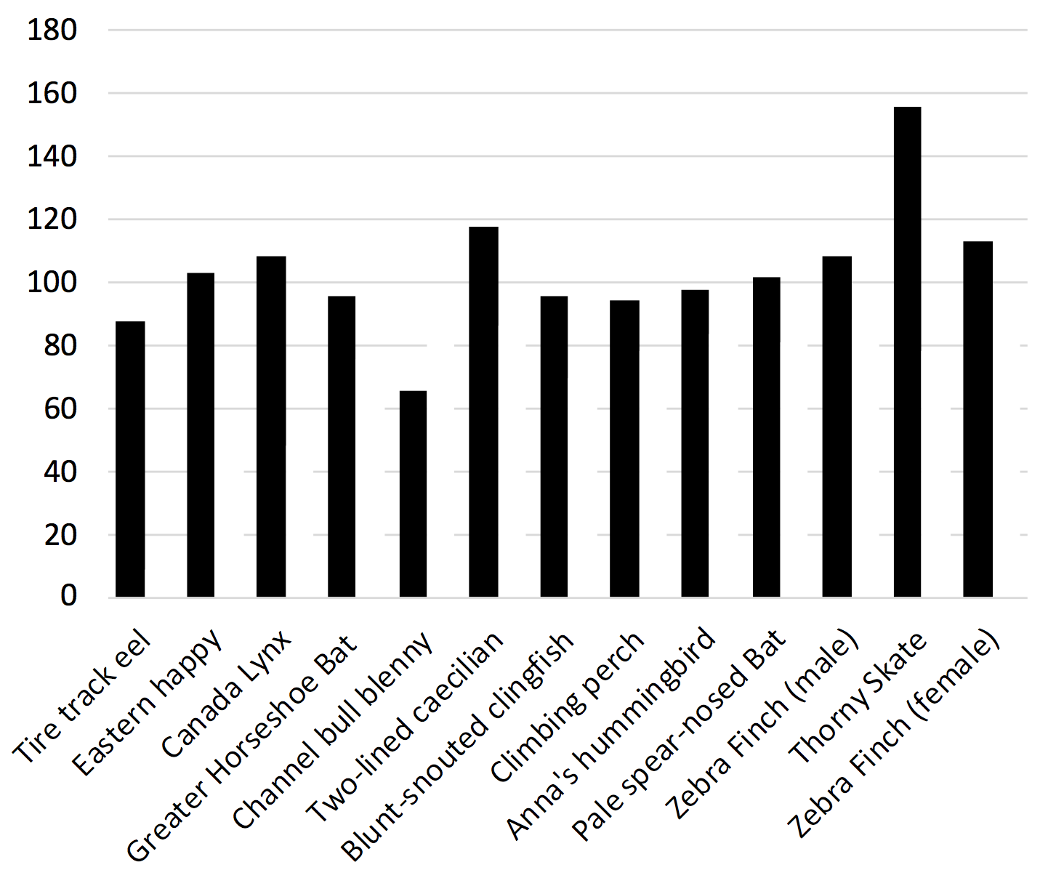
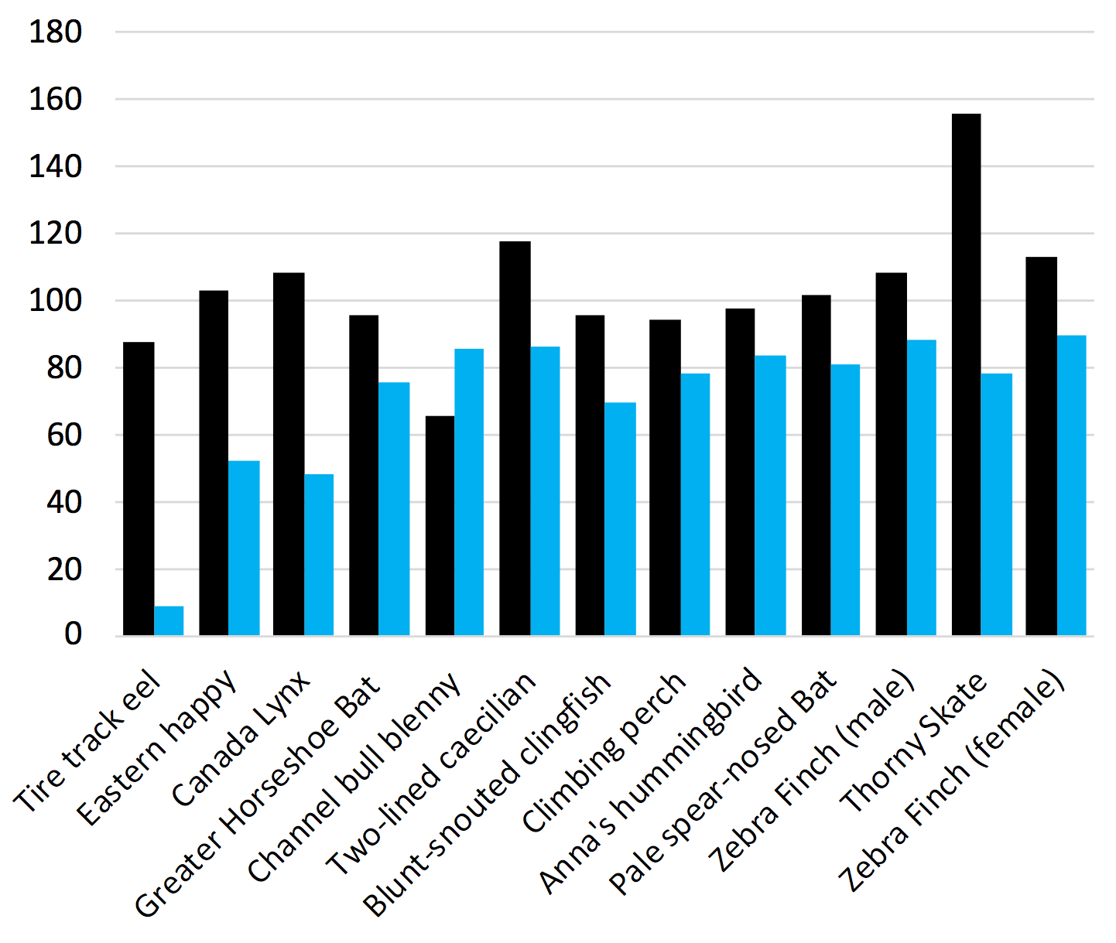
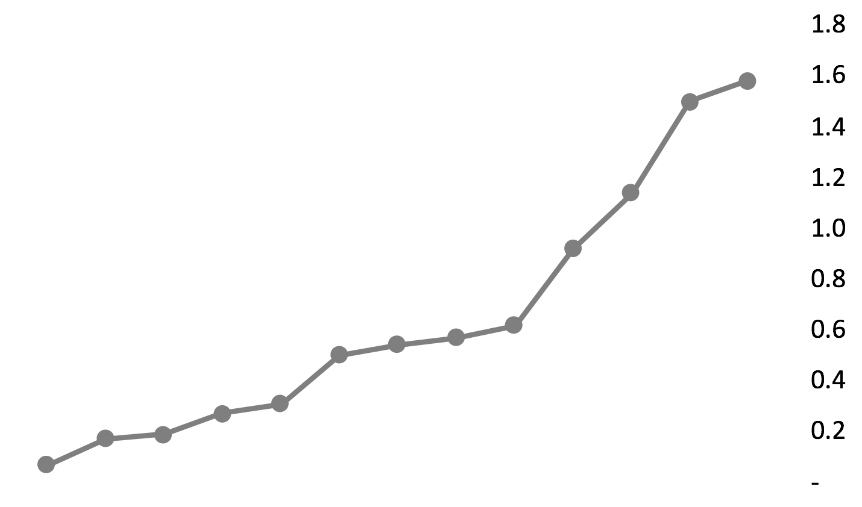
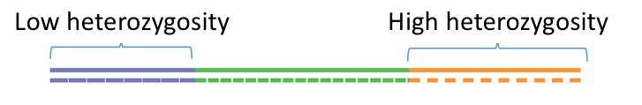
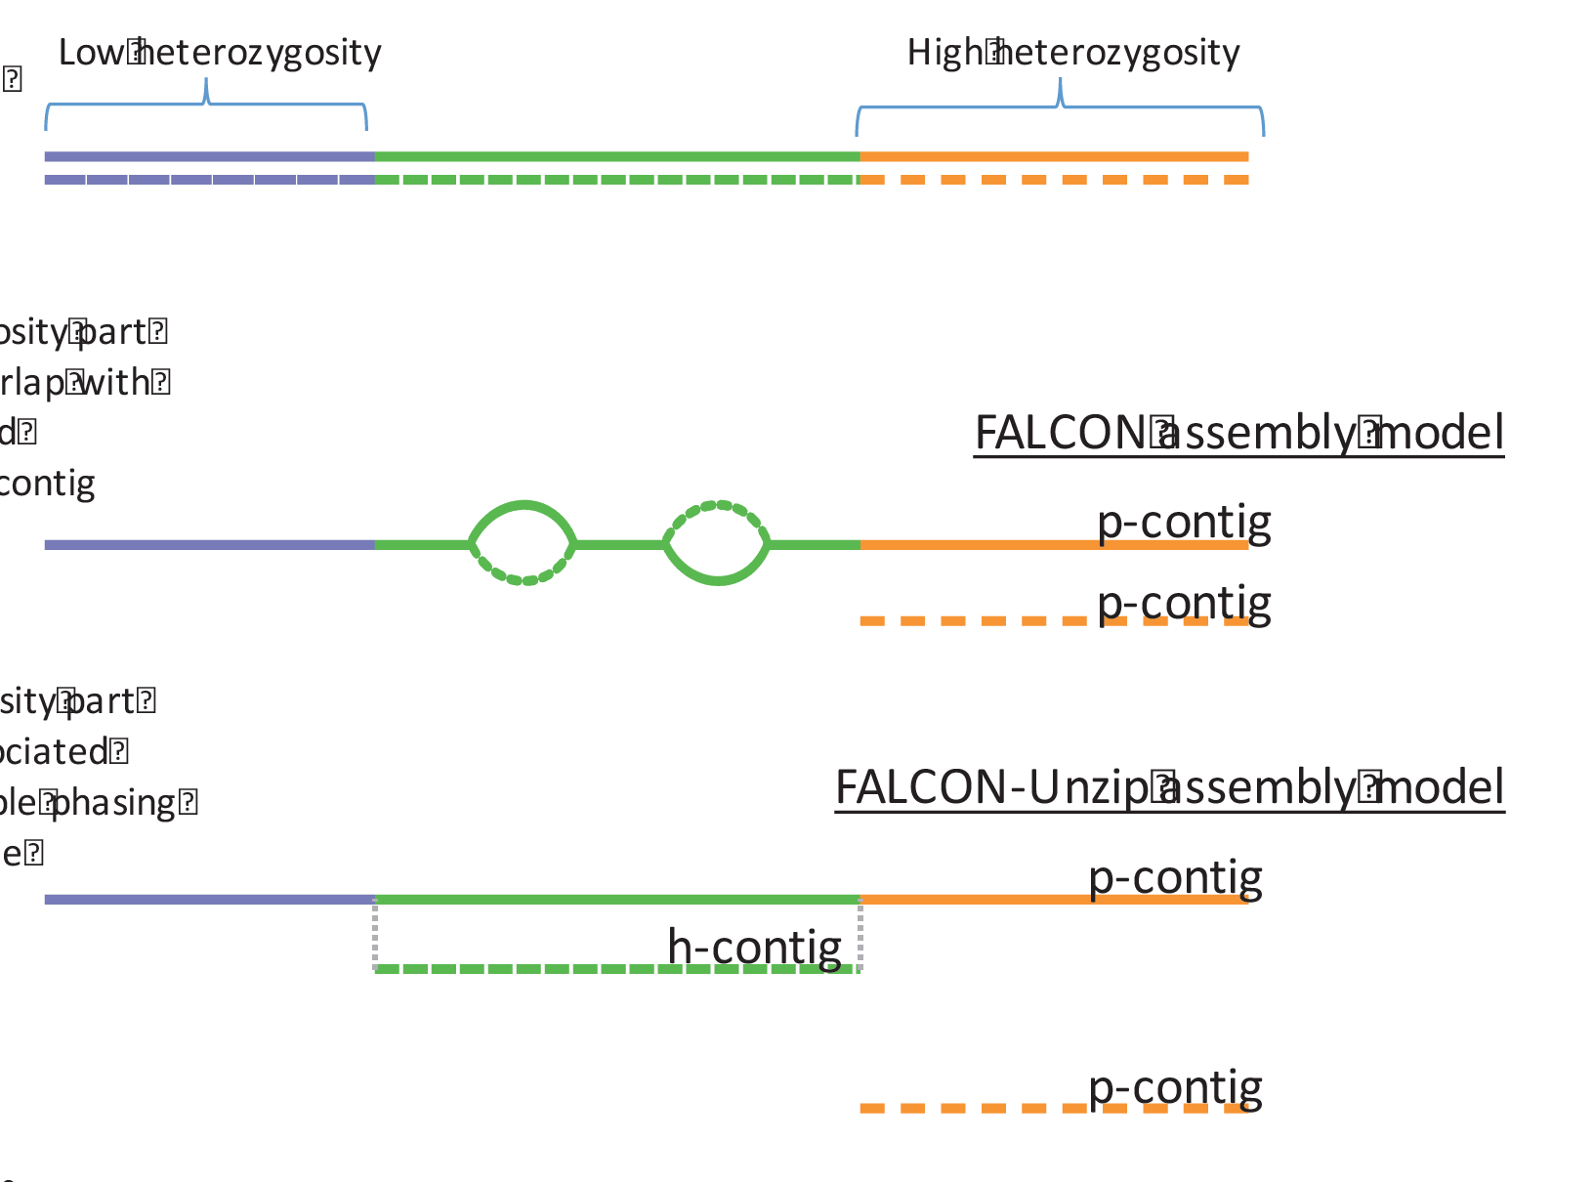
Heterozygosity and allelic duplication
Primary
Alternates
(%)
Assembled size / Exp. Genome Size
Heterozygosity (%)
Chin et al., Nat Met. (2016)
Human
Arang Rhie

Slide 24
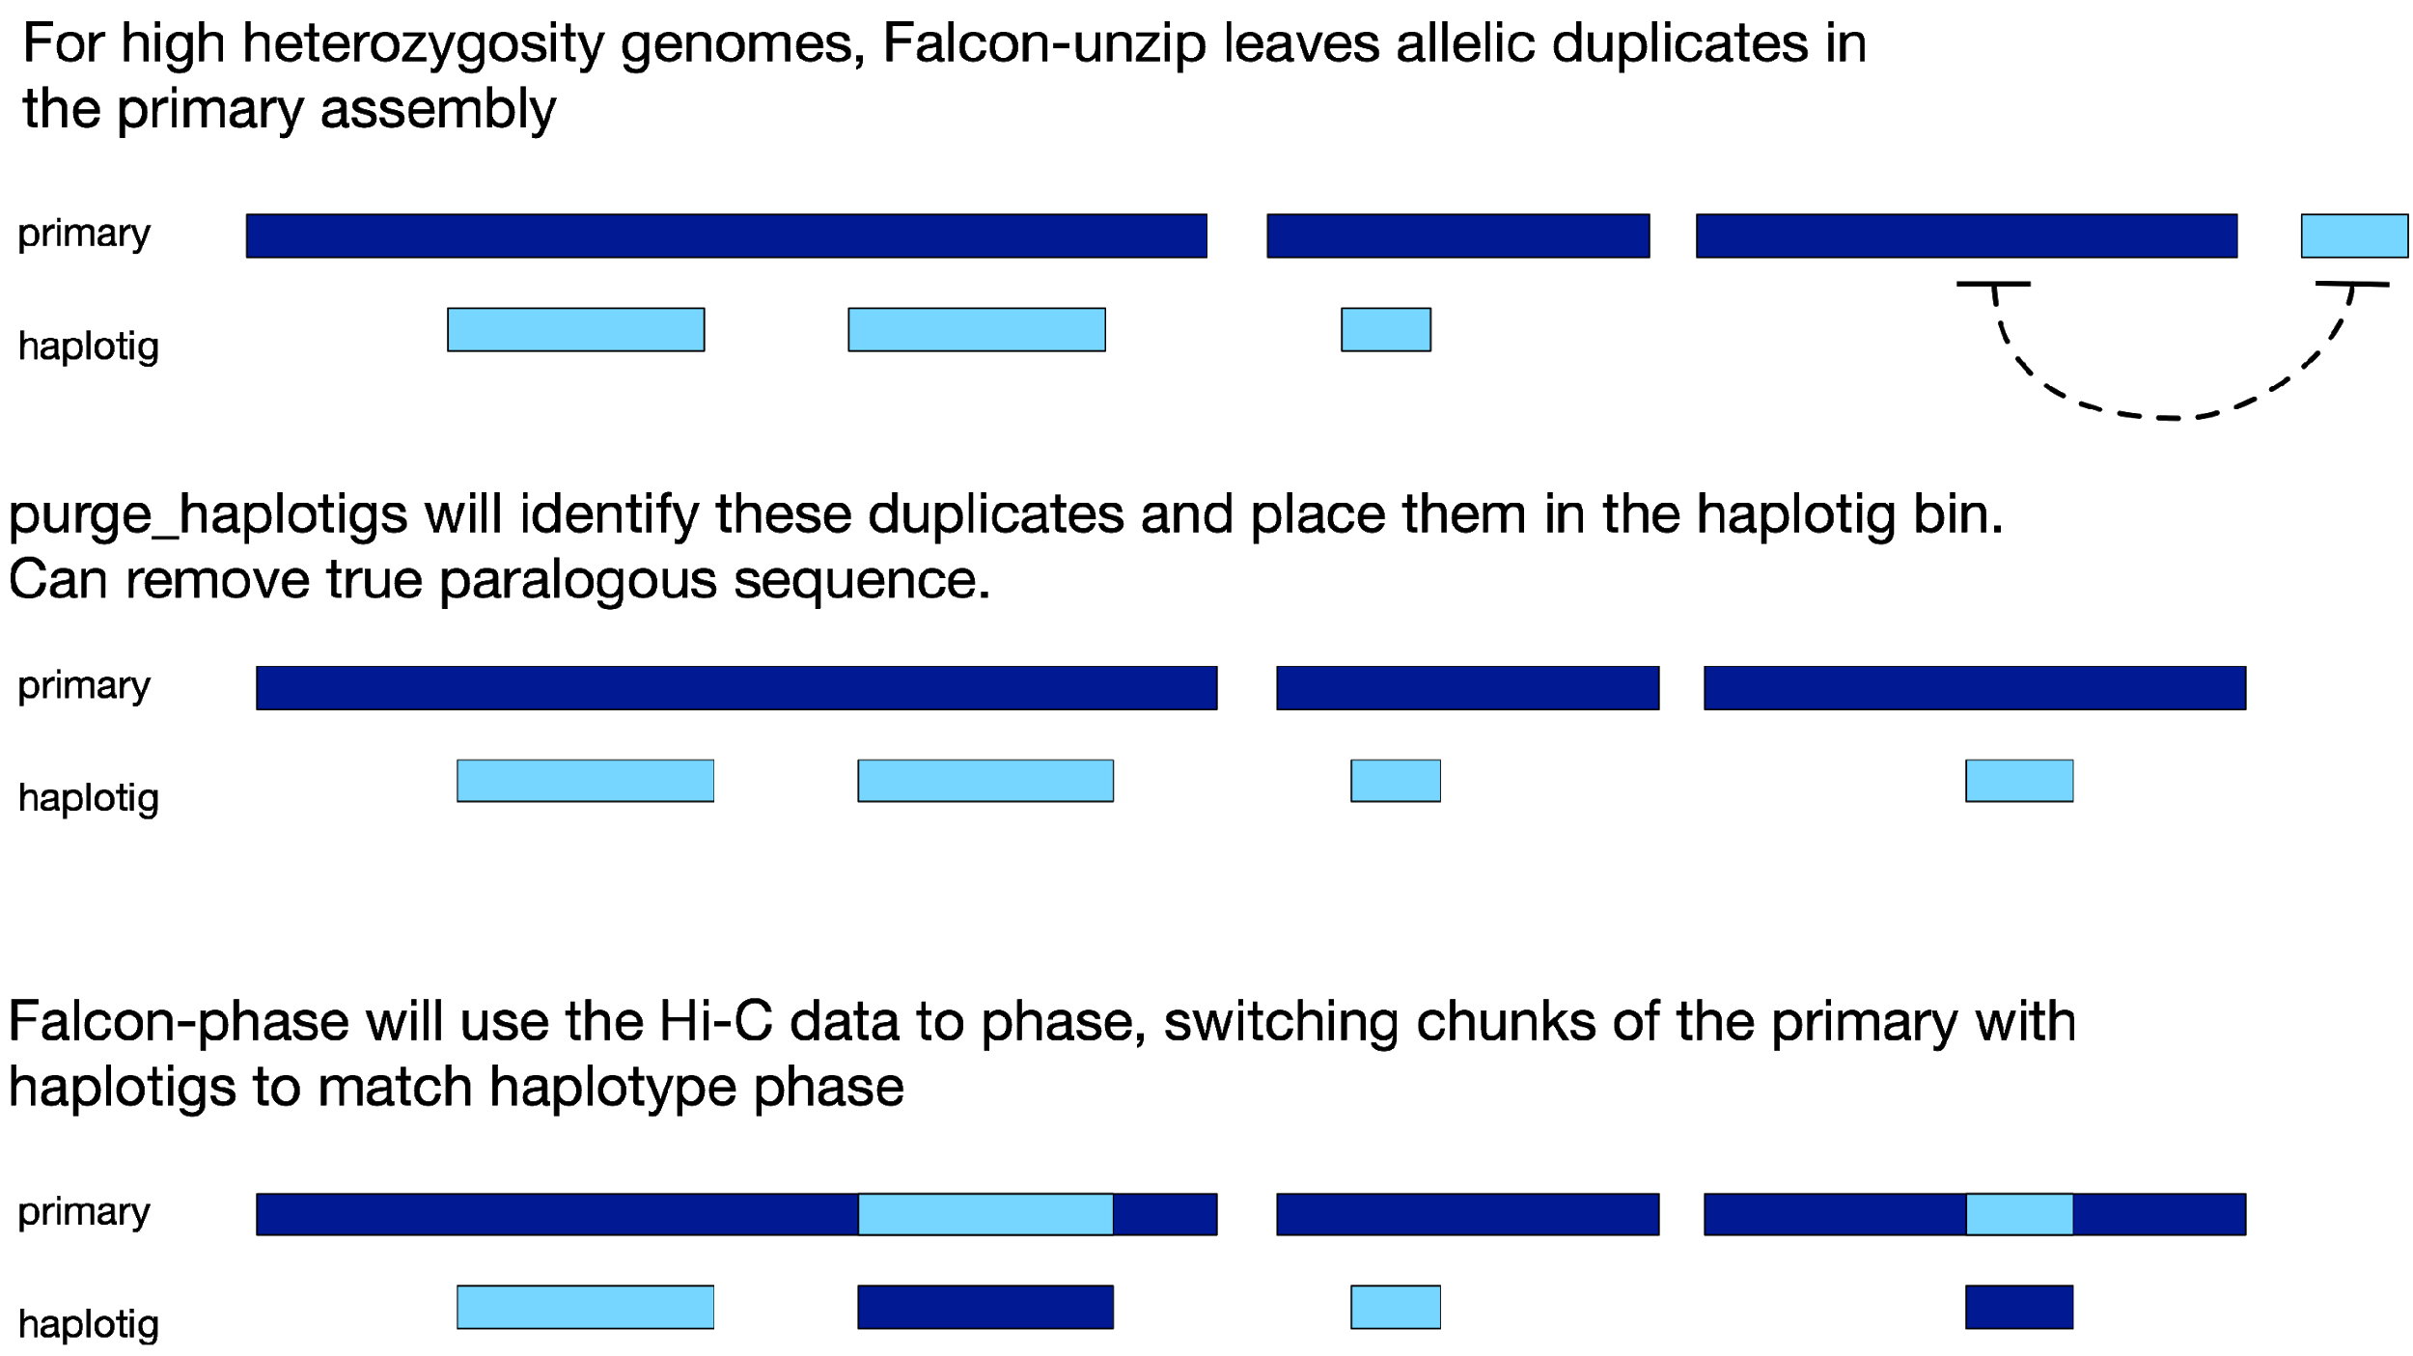
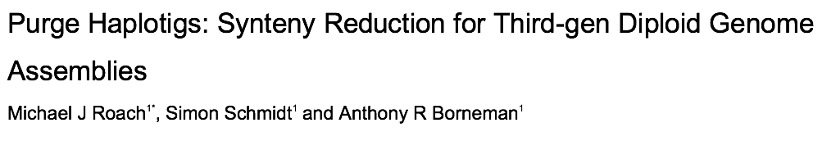
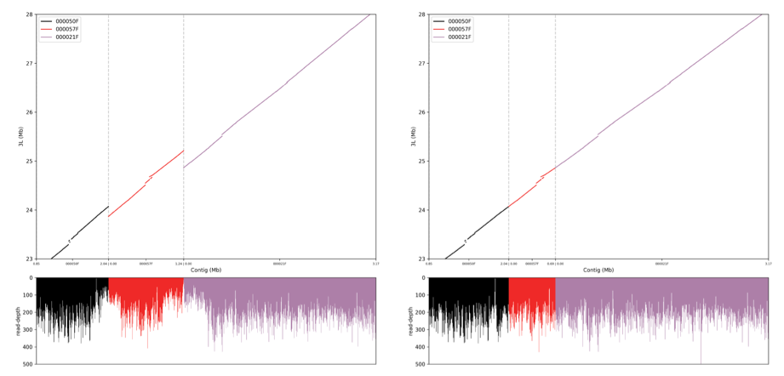
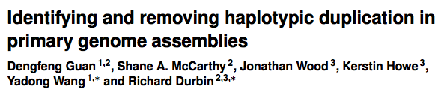
Dealing with haplotype duplication

Slide 25
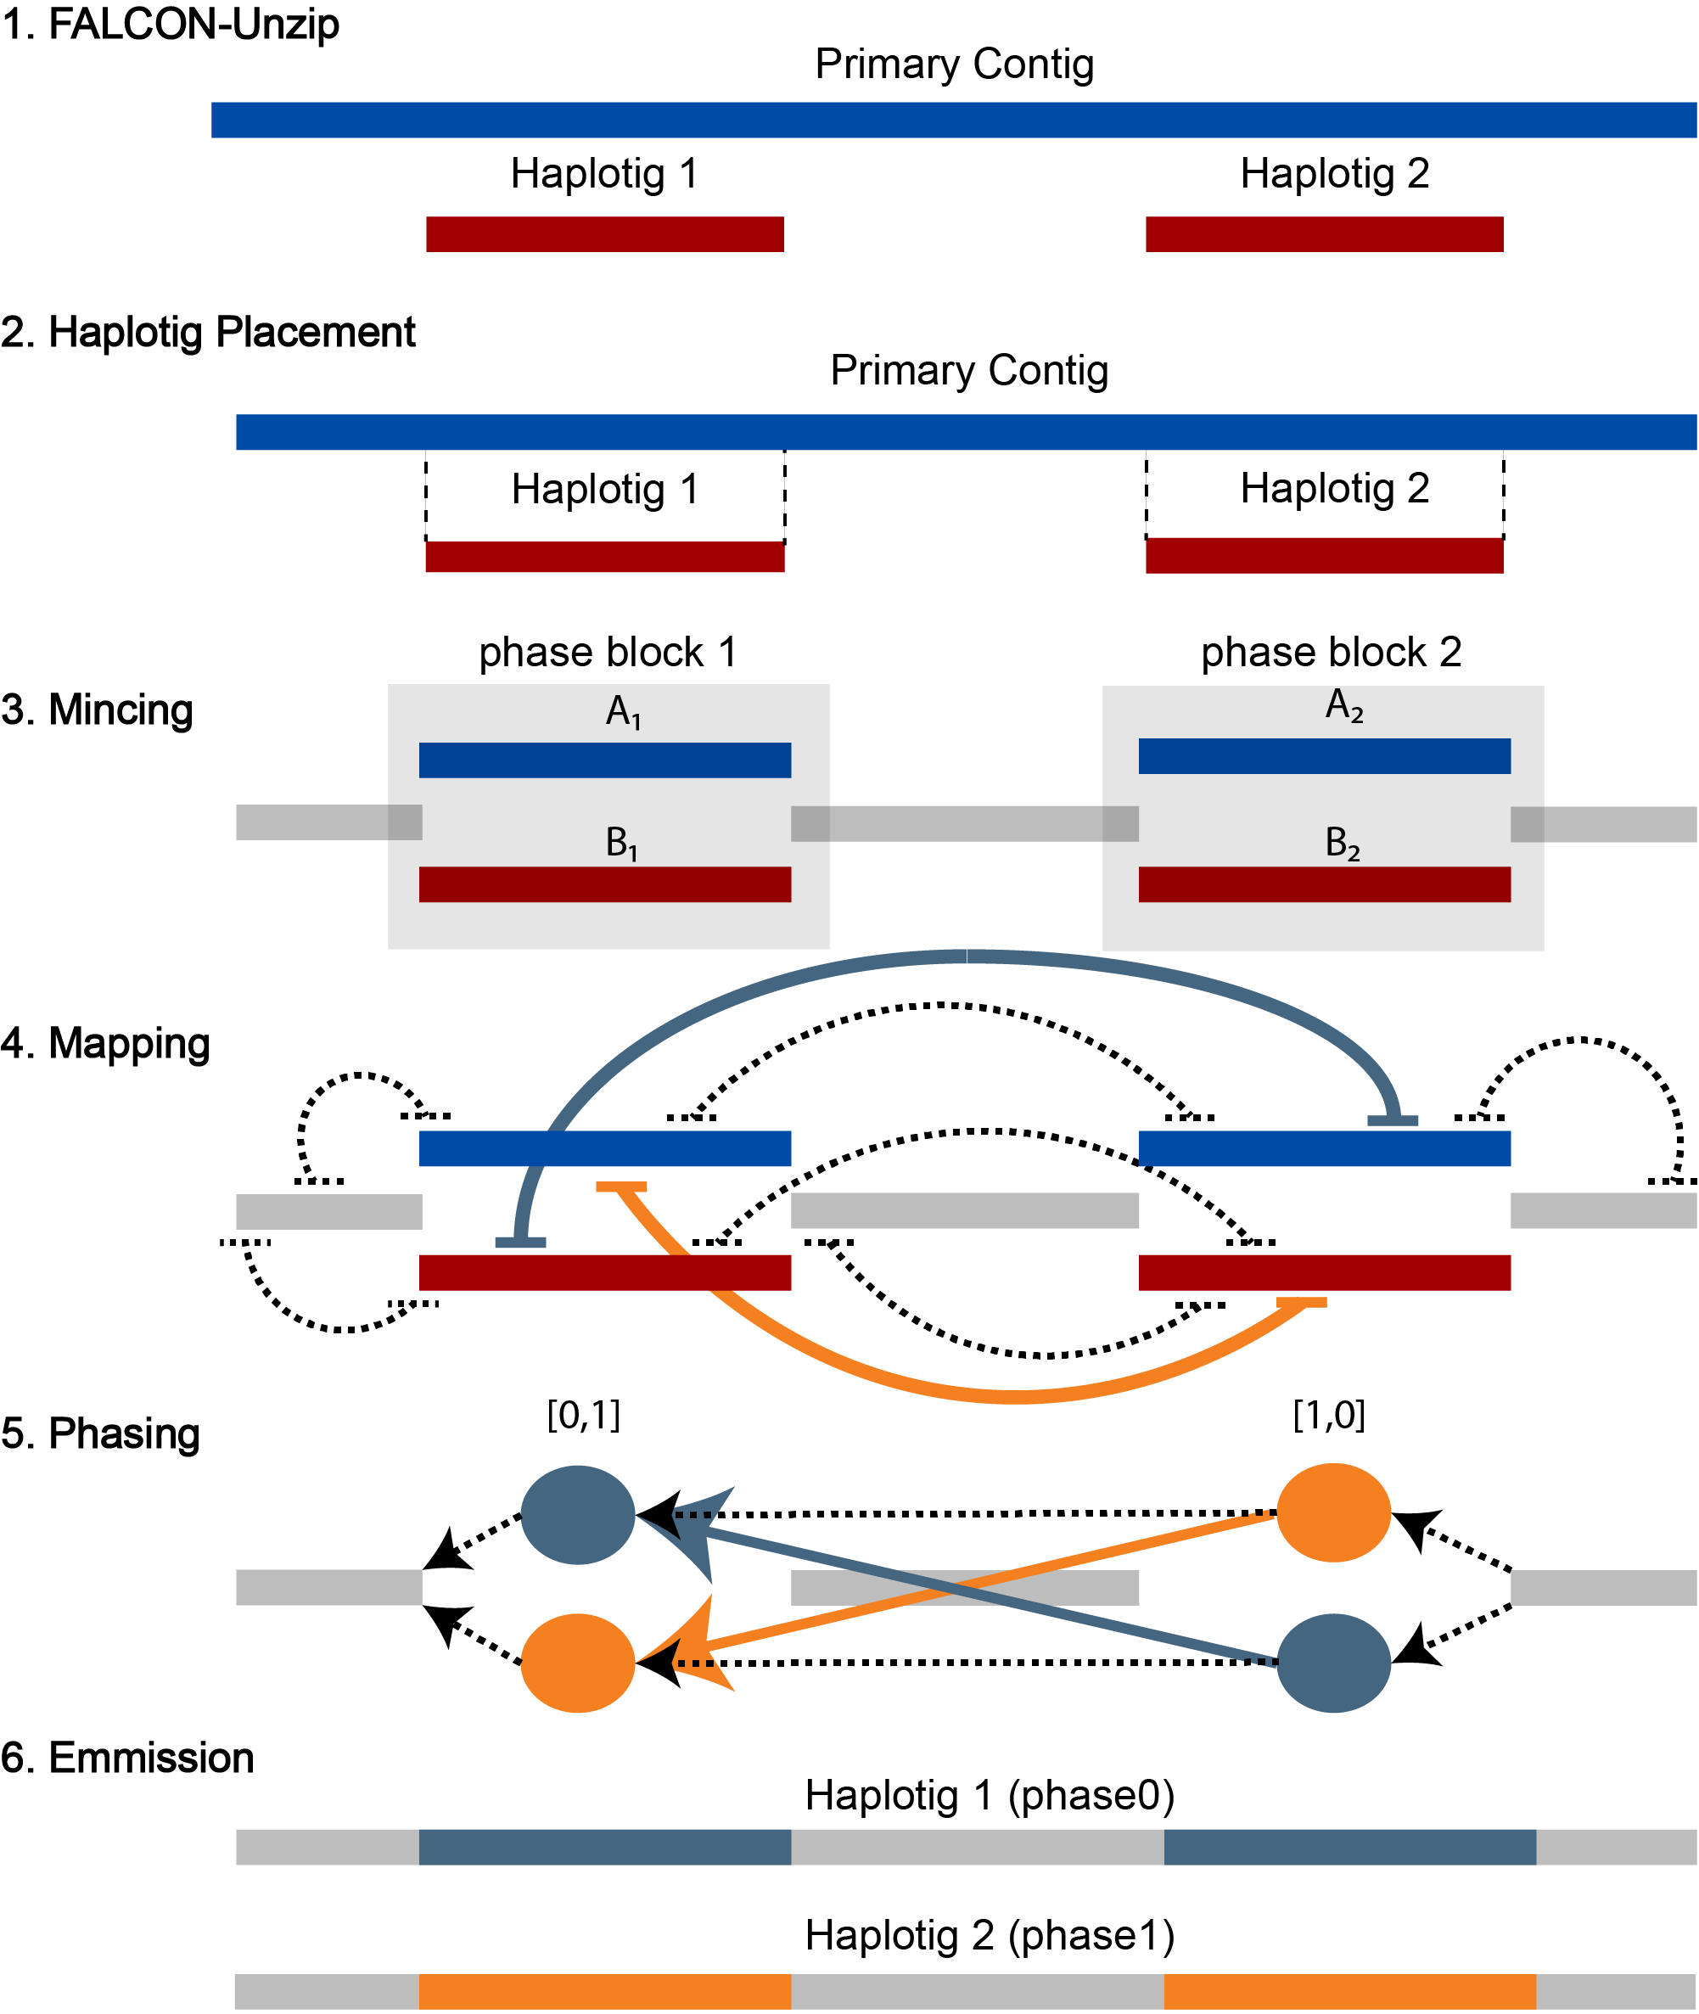
Falcon-phase
Use Hi-C data to help phase variants over a longer range than Falcon-unzip can do with SNP calls from PacBio reads alone.
FALCON-Phase: Integrating PacBio and Hi-C data for phased diploid genomes bioRxiv: https://doi.org/10.1101/327064

Slide 26




Genome assembly QC
Base Accuracy
Realign reads from the same species
Identify SNPs+indels. Indels - known to be enriched in Pacbio+Nanopore assemblies
k-mer completeness with respect to Illumina data (KAT)
Local structure accuracy
External evidence - e.g. sequencing data (REAPR, QUAST)
Known adjacencies, e.g. PCR primers or structural variants
Gene content
Order and orientation of genes/exons of known genes (e.g. housekeeping genes)
BUSCO: Quantitative assessment of genome assembly and annotation completeness based on evolutionarily informed expectations of gene content
Benchmarking Universal Single-Copy Orthologs
Start from set of conserved genes
Find them in the assembly
Assess whether they are Complete (C), Single copy (S) or Duplicated (D), Fragmented (F) or Missing (M)

Slide 27

Metagenomic assembly
What if your DNA sample is a mix of uncultured (probably microbial) organisms?
Abundances of the different components vary
Need to separate divergent sequences from errors
Output is typically a set of contigs, with coverage
Still a valuable simplification of a data set
What scaffolding approaches are suitable?
Ayling M, Clark MD, Leggett RM. New approaches for metagenome assembly with short reads. Brief Bioinform. February 2019. doi:10.1093/bib/bbz020.
Transcriptome assembly
Another important form of data is cDNA from a sample
Again no single linear underlying sequence, and abundances of different components vary
Alternative splicing generates branches
Packages: Trinity, TopHat

Slide 28

Tree of Life Project Sequencing Projects

Slide 29

Darwin Tree of Life Project

Slide 30

Darwin Tree of Life Project

Slide 31

Complete chromosome contigs

